Slide 1

Our Project: Buzz or Bust
Questionnaire: Data gathering
Case Studies : Neural Network and Randon Forest
Findings and Limitations: how might be used
Repo: https://github.com/jvbonini/WhyExpat_site
Team Members: Lei Qin | Rob Seaberg | Winnie Wu | Joao Victor Bonini

Slide 2


Slide 3
70 Million

Slide 4
www.
.net

Slide 5

Our Project

Slide 6
Our Project
'satisfaction_level'
'last_evaluation'
'promotion_last_5years'
'average_montly_hours',
'Work_accident'
'number_project'
'salary'
'leader_host'
'culture_host'
'culture_home'
'buzz_bust'
'function_host'
'business Size_host'
'economic Perspective_host'

Slide 7
Questionnaire
Data gathering
To be Included

Slide 8
Case Studies
Neural Network
Notes:
45 seg

Slide 9
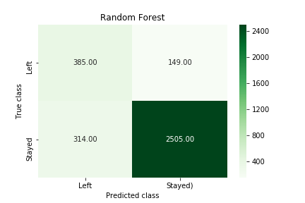
Case Studies
Random Forest
Random Forest
Model accuracy: 0.859
How likely people will stay if model predicts stay?
84.7% (without prediction)
94.3% (RF)
(2505/2654)
How much loss we prevent?
62.7%
To be Included
Notes:
Using test set
(94.3%-84.7%)/(1-84.7%)=62.7%

Slide 10
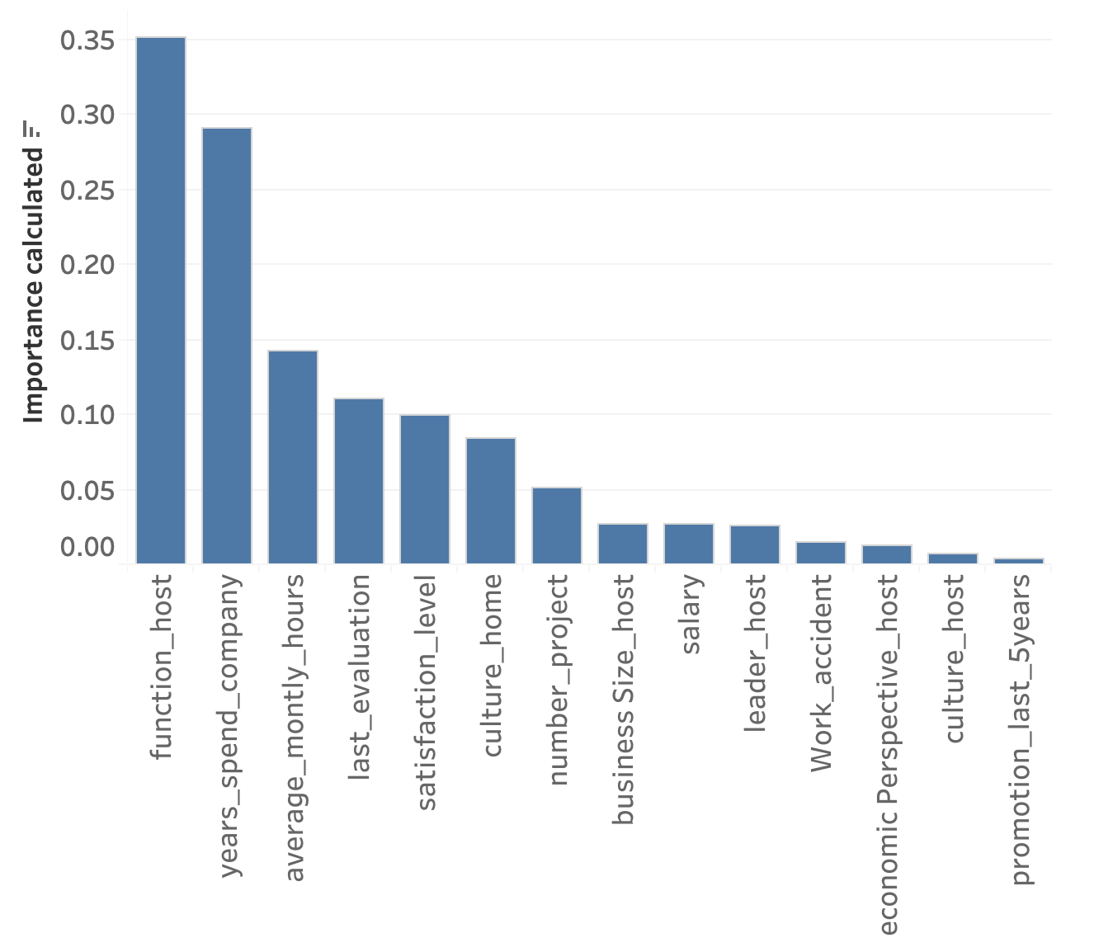
Case Studies
Random Forest
Random Forest
Understand the model: Feature importance

Slide 11
Case Studies
Random Forest
Random Forest
Understand the model: Feature importance
How data support the feature importance

Slide 12
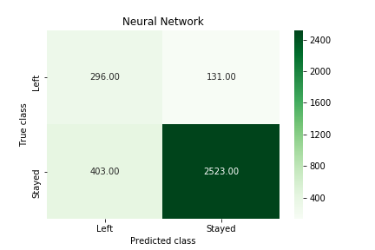
Case Studies
Random Forest
Neural Network
Model accuracy: 0.841 (loss: 0.324)
How likely people will stay if model predicts stay?
84.7% (without prediction)
95.1% (NN)
(2523/2654)

Slide 13
Findings and Limitations
How might be used
To be included

Slide 14
70 Million

Slide 15

...Questions

Slide 16

| End |
Lei Qin | Rob Seaberg | Winnie Wu |Joao Victor Bonini
www.
.net

Slide 18
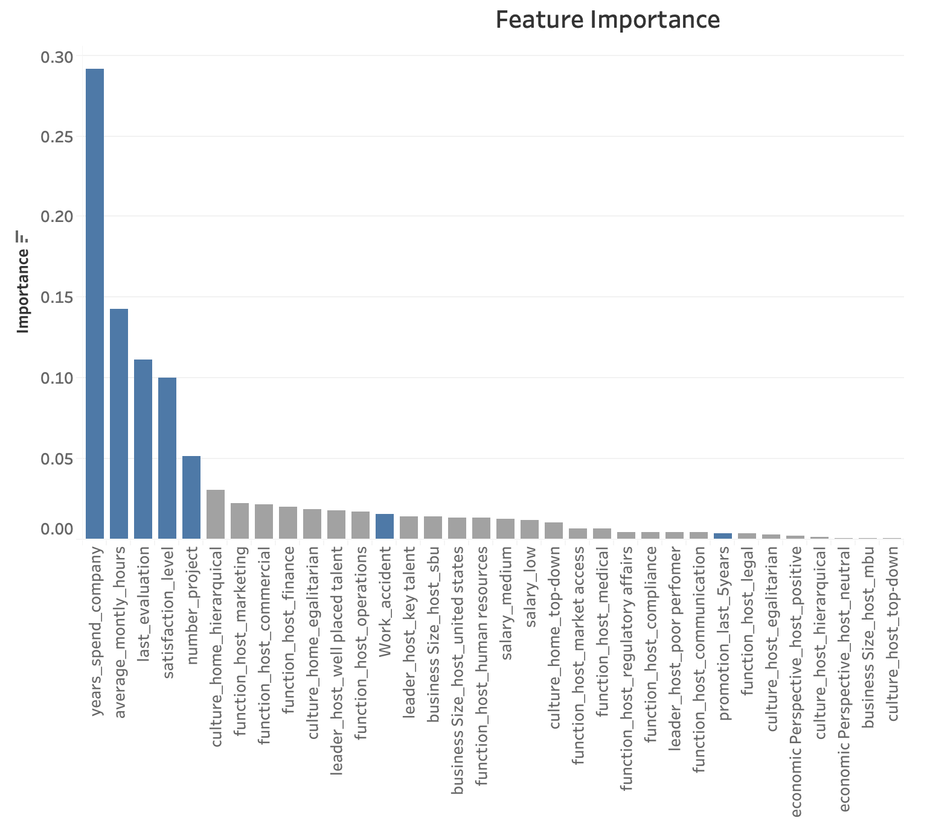
Notes:
Blue
Grey: catergorical data

Slide 19
Something we can work on
Model evaluation: Roc
Tree
Understand persion and recall (explain)
Perison recall
https://towardsdatascience.com/beyond-accuracy-precision-and-recall-3da06bea9f6c

